Slide 1
Glioblastoma
Multiforme
Andrew Wilk and Angela Bai
1

Slide 2
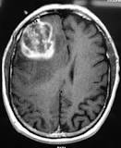
Overview
5% five-year survival rate
Resistant to common treatments
Most common malignant brain tumor
Genetics extensively characterized
2
Notes:
Most common malignant brain tumor, aggressive and have little chance of recovery. The five-year survival rate is only 5%.
Despite the genetics of glioblastoma being extensively studied, it has been resistant to all genotoxic therapies employed in clinical trials. The standard treatment offered to patients have only been minimally effective, so additional research is urgently required to identify therapeutic targets of glioblastoma.

Slide 3
Review Paper:
Glioblastoma Multiforme: An Overview of Emerging Therapeutic Targets (2019)
Olivia G. Taylor, Joshua S. Brzozowski, Kathryn A. Skelding
Frontiers in Oncology
Goals:
Outline current treatment options for glioblastoma multiforme (GBM)
Discuss recent advances in targeted therapies for GBM
3

Slide 4
Review Paper: Methodology
01
Current treatment options
04
Comparison of receptor inhibitors
02
Identified emerging therapies
05
Addressing limitations
03
Relevant literature selected
06
Future directions
4

Slide 5
Review Paper: Conclusions
A personalized therapeutic approach that stratifies GBM patients is necessary for patient survival rates to improve
There are several potential therapeutic targets:
Examples: EphA3, EGFR, VEGF, PDGFR, and MET
But inhibitors of these targets have only exhibited limited clinical success
To improve clinical outcomes, we need :
More basic research into GBM
Development of therapeutics that can maintain concentration across the BBB
5

Slide 6
Research Paper: Hypothesis
Employed multiple hypothesis testing:
Selection pressure for specific mutations occurs mostly during initial malignant transformation
Standard chemotherapy does not apply selective pressure at genetic level
Glioblastoma cells present high levels of phenotypic plasticity
6

Slide 7
Research Paper: Methodologies
A single-cell multi-omics atlas of GBM evolution under therapy
For 86 patient-matched primary-recurrent paired specimens, they performed:
01
snRNA-seq
04
Spatial Proteomics
02
scATAC-seq
05
Exome sequencing
03
Spatial Transcriptomics
7

Slide 8
Research Paper: Findings/Conclusions
Recurrent glioblastoma associated with MES phenotype
Hypotheses Supported
MES phenotype is inducible
Cellular targets for therapy
8

Slide 9
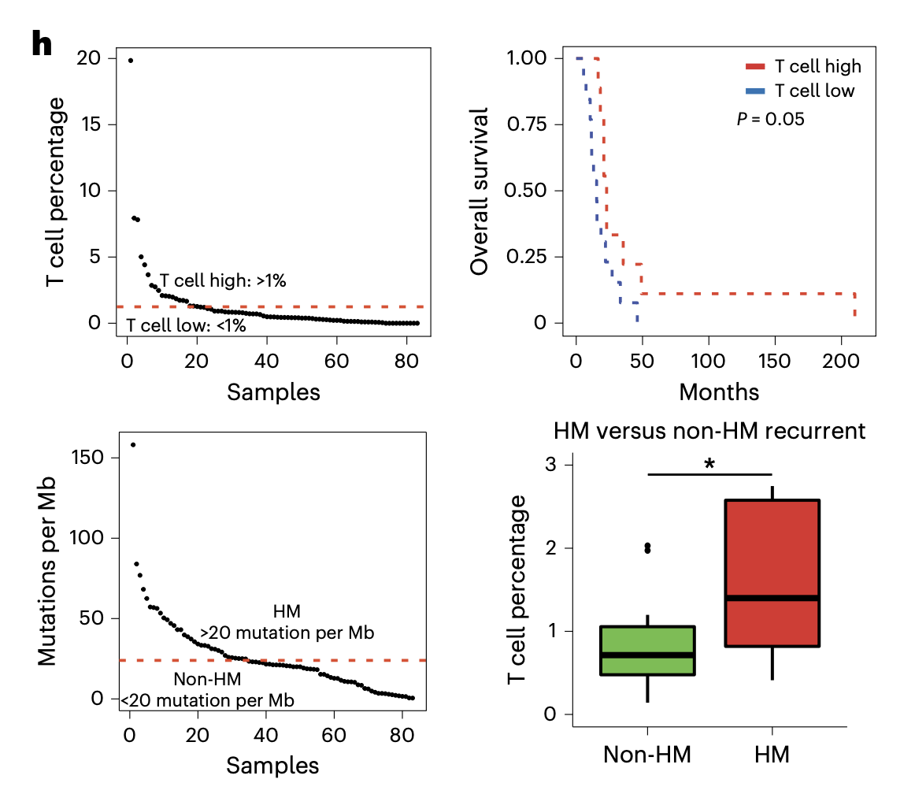
Figure 1
9

Slide 10
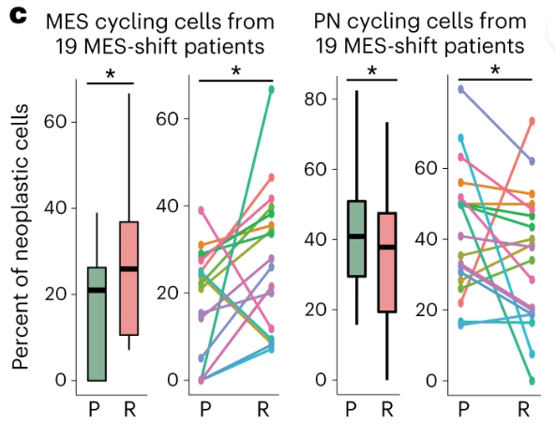
Figure 2
Notes
Distribution of cell phenotypes in GBM patients show association between MES phenotype and disease recurrence.
10

Slide 11
Questions
1
1
How might using a multi hypothesis approach limit or expand the relevance of this study?
2
2
How will the knowledge that the mesenchymal phenotype is inducible impact direction for disease treatment?
3
3
What challenges remain in designing therapeutics that can act on the targets found in this study?
11

